Slide 1
Introduction to XML Lecture 1 – part 1: Introduction
Eng. Marwa Abdel Hamid

Slide 2
XML → Extensible Markup Language
<tags>
Language → syntax
--------------------------------------------------------
XML is DB in text file .xml
Data.xml
<student id=“10”>
<name> Ahmed Mohamed</name>
<address>Smouha</address>
<Bdate>10/1/1999</Bdate>
<email>aa@gmail.com</email>
</student>
OR
JSON Data
id:10, name: Ahmed Mohamed, address: Smouha, email: aa@gmail.com
Application
JAVA, C#, PHP, …..
XML Parser
XML File

Slide 3
History of Mark up Language
ML
Specific ML
HTML
(browser)
RTF
Rich Text Formatting
Generalized ML
XML

Slide 4
Introduction to XML
Stands for eXtensible Markup Language.
XML is currently managed by the World Wide Web Consortium (W3C)
www.w3.org
Created to provide a standard format for computer documents that is used as:
– Websites documents
– Desktop applications
– Electronic data interchange documents (EDI)
– Mobile applications

Slide 5
What is XML?
XML is the universal format for representing structured information.
XML is simple, text only, and portable.
Self describing for the data it contains, “Because it separates the content from its presentation”.

Slide 6
What is XML? (Cont’d)
Standard Based
Language independent.
Platform independent.
Application independent.
XML is a set of rules for designing text formats for data in a way that produces files that are easy to generate and read, unambiguous, and platform-independent.

Slide 7
What is XML? cont’d
XML is about describing data.
XML separates the data from it’s presentation.
XML is just a text file.
XML, unlike HTML, doesn’t have a fixed or predefined set of tags.
The designer of the XML document invent his own set of tags.

Slide 8
XML as import and export format
As a universal format for data, XML is an ideal format for importing and exporting data between applications and between platforms.
Data from different databases can be transformed to XML for standardization and easy manipulation such as in the cases of database migration.
Oracle
Mysql
DBMS disadvantage
DBMS is incompatible with another DBMS
Oracle
Open with Mysql?????? No
XML
DB
DB

Slide 9
Storing and sharing data
Storing data in XML file can reduce the complexity of storing it in database. (Administrating DB, incompatible format).
Sharing data is more powerful due to platform and software independent.
You can expand, upgrade or change your O.S., servers or applications.
Database and XML?????

Slide 10
Configuration Files
XML files are being used for many purposes at the operating system level. In the operating system environment such as Windows and Linux Operating Systems. XML is used for maintaining core configuration information.
Application
Data

Slide 11
Create new Languages
Due to universal data format in XML, several specialized XML applications were developed such as:
- XHTML (HTML5) = HTML 4 + XML - CML (Chemical ML)
- WML (Wireless ML) - MusicML (Musical ML)
MathML (Math ML) - XAML
RSS (Really Simple Syndication) - SVG (Scalar Vector Graphics)
WSDL (Web Services Description Language) using (EDI)
Many others applications (http://xml.coverpages.org/xml.html#applications)

Slide 12
XML Syntax

Slide 13
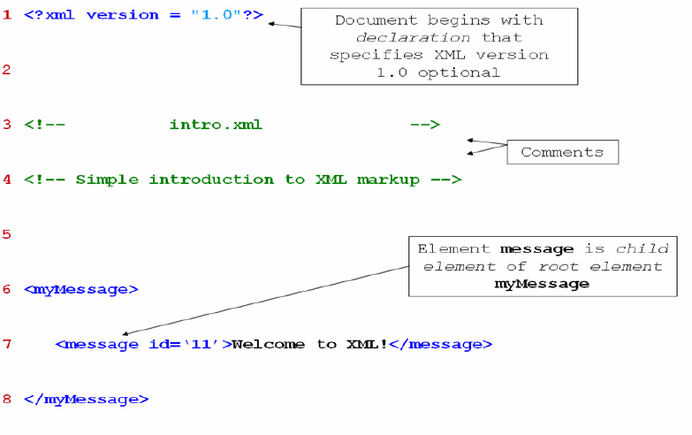
XML example
Prolog
XML Elements

Slide 14
Document Structure
Commonly stored in .xml file
XML document has a hierarchical structure with two sections:
First section: Known as Prolog that contains:
XML Declaration
XML Comments
Processing Instruction
Second section: contains the body of the document (XML elements).

Slide 15
XML Document parts: Example
<?xml version=“1.0” encoding=“UTF-8” standalone=“no”?>
<!DOCTYPE bookstore “bookstore.dtd”>
<?stylesheet type=“text/xsl” href=“book.xsl”?>
<!- - This is a comment - ->
<bookstore>
<book category=“COMPUTER” category=“Mobile”>
<title>Introduction to XML</title>
<year>2009</year>
<price>300</price>
</book>
</bookstore>
<book category=“Science”>
XML
declaration
DTD Declaration
Processing
Instructions
Prolog
Comment
Root Element = Document Element
Nested
Elements

Slide 16
Body Structure
XML document contains only one root element, known also as document element.
All other elements are child elements for the root element.
Each element has start tag and end tag <Book> …</Book>
– Empty element can be defined as: <endElement/>
Tags must be well nested
– Incorrect: <x><y>hello</x></y>
– Correct: <x><y>hello</y></x>

Slide 17
Body structure (cont’d)
Attribute values in quotes.
Tags & Attributes names can be written as variable names:
– Start with character,
– One word “must not contain spaces”,
– Case sensitive.
An element must not have two attributes with the same name.

Slide 18
Rules of Elements Naming
Names can contain letters, numbers and other characters.
Names must not start with numbers or punctuation characters.
Names must not start with the letters xml.
Names can not contain spaces.
Names can not contain “:” because it is reserved to Namespaces.

Slide 19
Rules for Well Formed XML document
XML document is well formed if:
It has single root element.
Each element has start tag and end tag.
All tags must be balanced - <TAG>...</TAG>
Empty tags expressed - <EMPTY_TAG/> as <br/> in html
Tags must be nested - <B><I>…</I></B> .... Correct Nesting
All element attributes must be quoted:- <TAG name=“value”> or <TAG name=‘value’>
Text is case-sensitive:- <TAG> != <Tag>
Comments are allowed:- <!-- … -->
Must begin with XML declaration <?xml version=“1.0” ?>
Special characters must be escaped (Use Built-in Entity Reference or CDATA section)

Slide 20
Remember: Well-formed document
If the XML document verifies the previous rules, it is called a well-formed document.
Operating Systems
Windows, Linux, Mac
XML Parser = XML Processor
XML document Data Only
XML Parser = XML Processor
MS SQL Server (any DBMS)
Browser
XML Parser = XML Processor

Slide 21
XML Processor
It is also called XML Parser.
– Processes XML document:
• Reads XML document.
• Checks syntax.
• Reports errors (if any).
– Example:
Internet browser
XML Editors (ex:- XMLSpy)
Built component in Java JDK.
Visual Studio
Android Studio
DBMS (MS SQL server)

Slide 22
Application
JAVA , C#, PHP, Python, …
Std1
Std2
Std n
XML
<student ID=“8776”>
<Q1>A</Q1>
<Q2>D</Q2>
….
</student>
XML
XML
DBMS (Concurrency) Lock table insert/update
XML Document
DB

Slide 23
Entity References and Built-in Entities
• XML-reserved characters:
– Ampersand (&)
– Left-angle bracket (<)
– Right-angle bracket (>)
– Apostrophe (’)
– Double quote (”)
• But How to make this sequence
– “ 5 < x && y > 6” in element message ?!!!

Slide 24
Entity References and Built-in Entities (Cont’d)
Entity references (Example)
– Allow to use XML-reserved characters
Begin with ampersand (&) and end with semicolon (;)
Build-in entities:
(&) → (&amp;) (<) → (&lt;)
(>) → (&gt;) (’) → (&apos;)
(”) → (&quot;)
So:
<code>5 < x && y > 6</code> → written as
<code>5 &lt; x &amp;&amp; y &gt; </code>

Slide 25
CDATA Sections
CDATA sections:
– May contain text, reserved characters and white space
Reserved characters does not need to be replaced by entity references
– Not processed by XML parser
– Commonly used for scripting code (e.g. JavaScript)
– Begin with <![CDATA[
– Terminate with ]]>

Slide 26
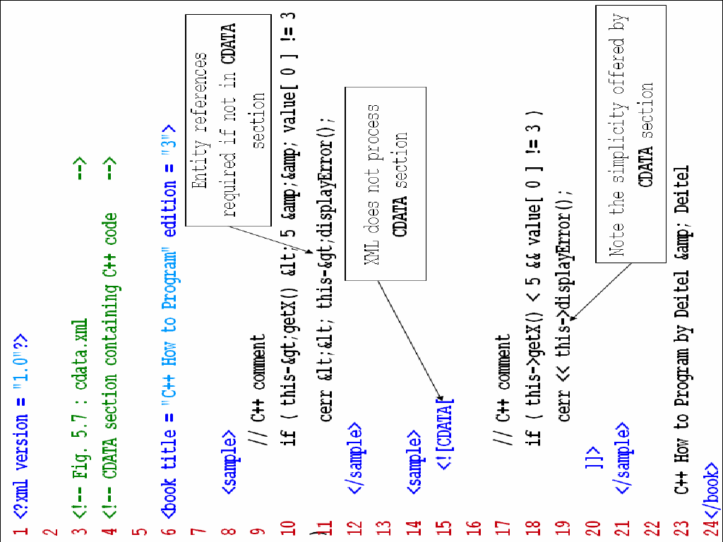
CDATA Example

Slide 27
XML Attribute
• Attributes:
– Elements may have associated attributes:
– Placed within element’s start tag:
– Values are enclosed in quotes (single or double):
Ex:
<Book ISBN = “112233548” title=“Introduction to XML” author=“Aly” author=“John”/>
• Element Book contains:
– attribute ISBN, which has value “112233548”
– attribute title, which has value “Introduction to XML”
– attribute author, which has value “Aly”
<Books>
<Book author1=“kkk” author2=“uuu”>
<ISBN>112233548</ISBN>
<title>XML</title>
<author>Aly</author>
<author>John</author>
</Book>
<Book ISBN=“122555”>
<title>DB</title>
<author>
<name>Aly</name>
<phone>452455</phone>
</author>
</Book>
<Book ISBN=“7653” title=“SQL”/>
</Books>

Slide 28
<iti>
<student id=“123”>
<name>
<fname>Ahmed</fname>
<lname>Mohamed</lname>
</name>
</student>
<student>
<name>Asmaa Aly</name>
</student>
</iti>
-----------------------------------------------------
<iti>
<student id=“123”>
<name fname=“Ahmed” lname=“Mohamed”/>
<Bdate>30/12/1999</Bdate>

Slide 29
Attributes (Cont’d)
Some problems using attributes:
Attributes can’t contain multiple values.
Attributes aren’t easily expanded for any changes.
Attributes can’t describe structure of XML document.
Attributes are more difficult to manipulate by program code.
When are attributes used?
In metadata.
In assigning ID reference to element.

Slide 30
Elements Types
<Books>
<Book>
<ISBN>112233548</ISBN>
<title>XML</title>
<author>Aly</author>
<author>John</author>
</Book>
<Book ISBN=“122555”>
<title>DB</title>
<author>
<name>Aly</name>
<phone>452455</phone>
<email/>
</author>
</Book>
<Book ISBN=“7653” title=“SQL”/>
</Books>
Element(s) content.
Mixed content.
Simple content (text content).
Empty content.
Attribute content.

Slide 31
Elements Types (Cont’d)
Example:
<Book>
<title>My first XML</title>
<prod id=”003” media=“paper”/>
<Author>Author Information
<name>Aly</name>
<email>aly@mm.com</email>
</Author>
</Book>
Book Elements content
Author Mixed content
title, name, email Simple content
Prod Attribute content, empty content

Slide 32
Relationship between XML elements
Book
title
My First XML
prod
Id=003
Author
Media=paper
name
email
Aly
aly@mm.com
Author Information

Slide 33
Linking XML with CSS file
Book.css
library
{
background-color: #000000;
width: 100%;
}
book
{
display: block;
margin-bottom: 30pt;
margin-left: 0pt;
}
title, author
{
color: #ff0000;
font-size: 20pt;
}
pubDate
{
color: #00ff00;
font-size: 20pt;
}
Book.xml
<?xml version=“1.0”?>
<?xml-stylesheet type=“text/css” href=“book.css”?>
<library>
<book>
<title>XML</title>
<author>Ahmad</author>
<pubDate>30/12/2001</pubDate>
</book>
<book>
<title>XSL</title>
<author>Mohamed</author>
<pubDate>13/1/2002</pubDate>
</book>
</library>

Slide 34
References & Recommended Reading
• XML in a nutshell, o’reilly.
• Web published:
- www.zvon.org
- www.w3.org
- www.xml.org
- www.w3schools.com

Slide 35
Install Altova XMLSpy
Lab Exercise

Slide 36
Assignment 1: Employee Data
Design a contacts file for employees and display them using CSS:
– Info. of each employee consists of a name, phones, addresses, and e-mail.
– The phones element may have more than phone element.
– Each phone element has one attribute called Type. The Type attribute takes one of the following values: home, work or mobile.
– The addresses element may have more than address element.
– Each address element must consist of the following elements: Street, Building Number, Region, City, and Country.
– The element e-mail must be exist for all employees.

Slide 37
Assignment2: A Library Data
• Design a configuration file for a library:
– Info. of library consists of a location, a description of the library, a librarian and a lot of books.
– Books contains many book elements.
– Each book has title, ISBN, and Author. The book contains also a preface and many parts.
– Each part has title and contains many chapters.
– Each chapters has chapter element.
– Each chapter has title and contains a summary and many sections.
– Sections contain the content of the book as paragraphs.

Slide 38
Self Study (XML Parsing)
How to read and write in XML file using JAVA
XML classes

Slide 39
Parsing XML with JAVA
Java supports two methods for XML parsing:
SAXParser
http://download.oracle.com/javase/6/docs/api/javax/xml/parsers/SAXParserFactory.html
Example:-
http://www.mkyong.com/java/how-to-read-xml-file-in-java-sax-parser/
DOMParser:
http://download.oracle.com/javase/6/docs/api/javax/xml/parsers/DocumentBuilderFactory.html
Example:-
http://www.mkyong.com/java/how-to-read-xml-file-in-java-dom-parser/
Oracle material for XML Parser: (XML Developer's Kit Programmer's Guide,)
https://docs.oracle.com/cd/B28359_01/appdev.111/b28394/toc.htm

